Slide 1
Nutrition in plants

Slide 2
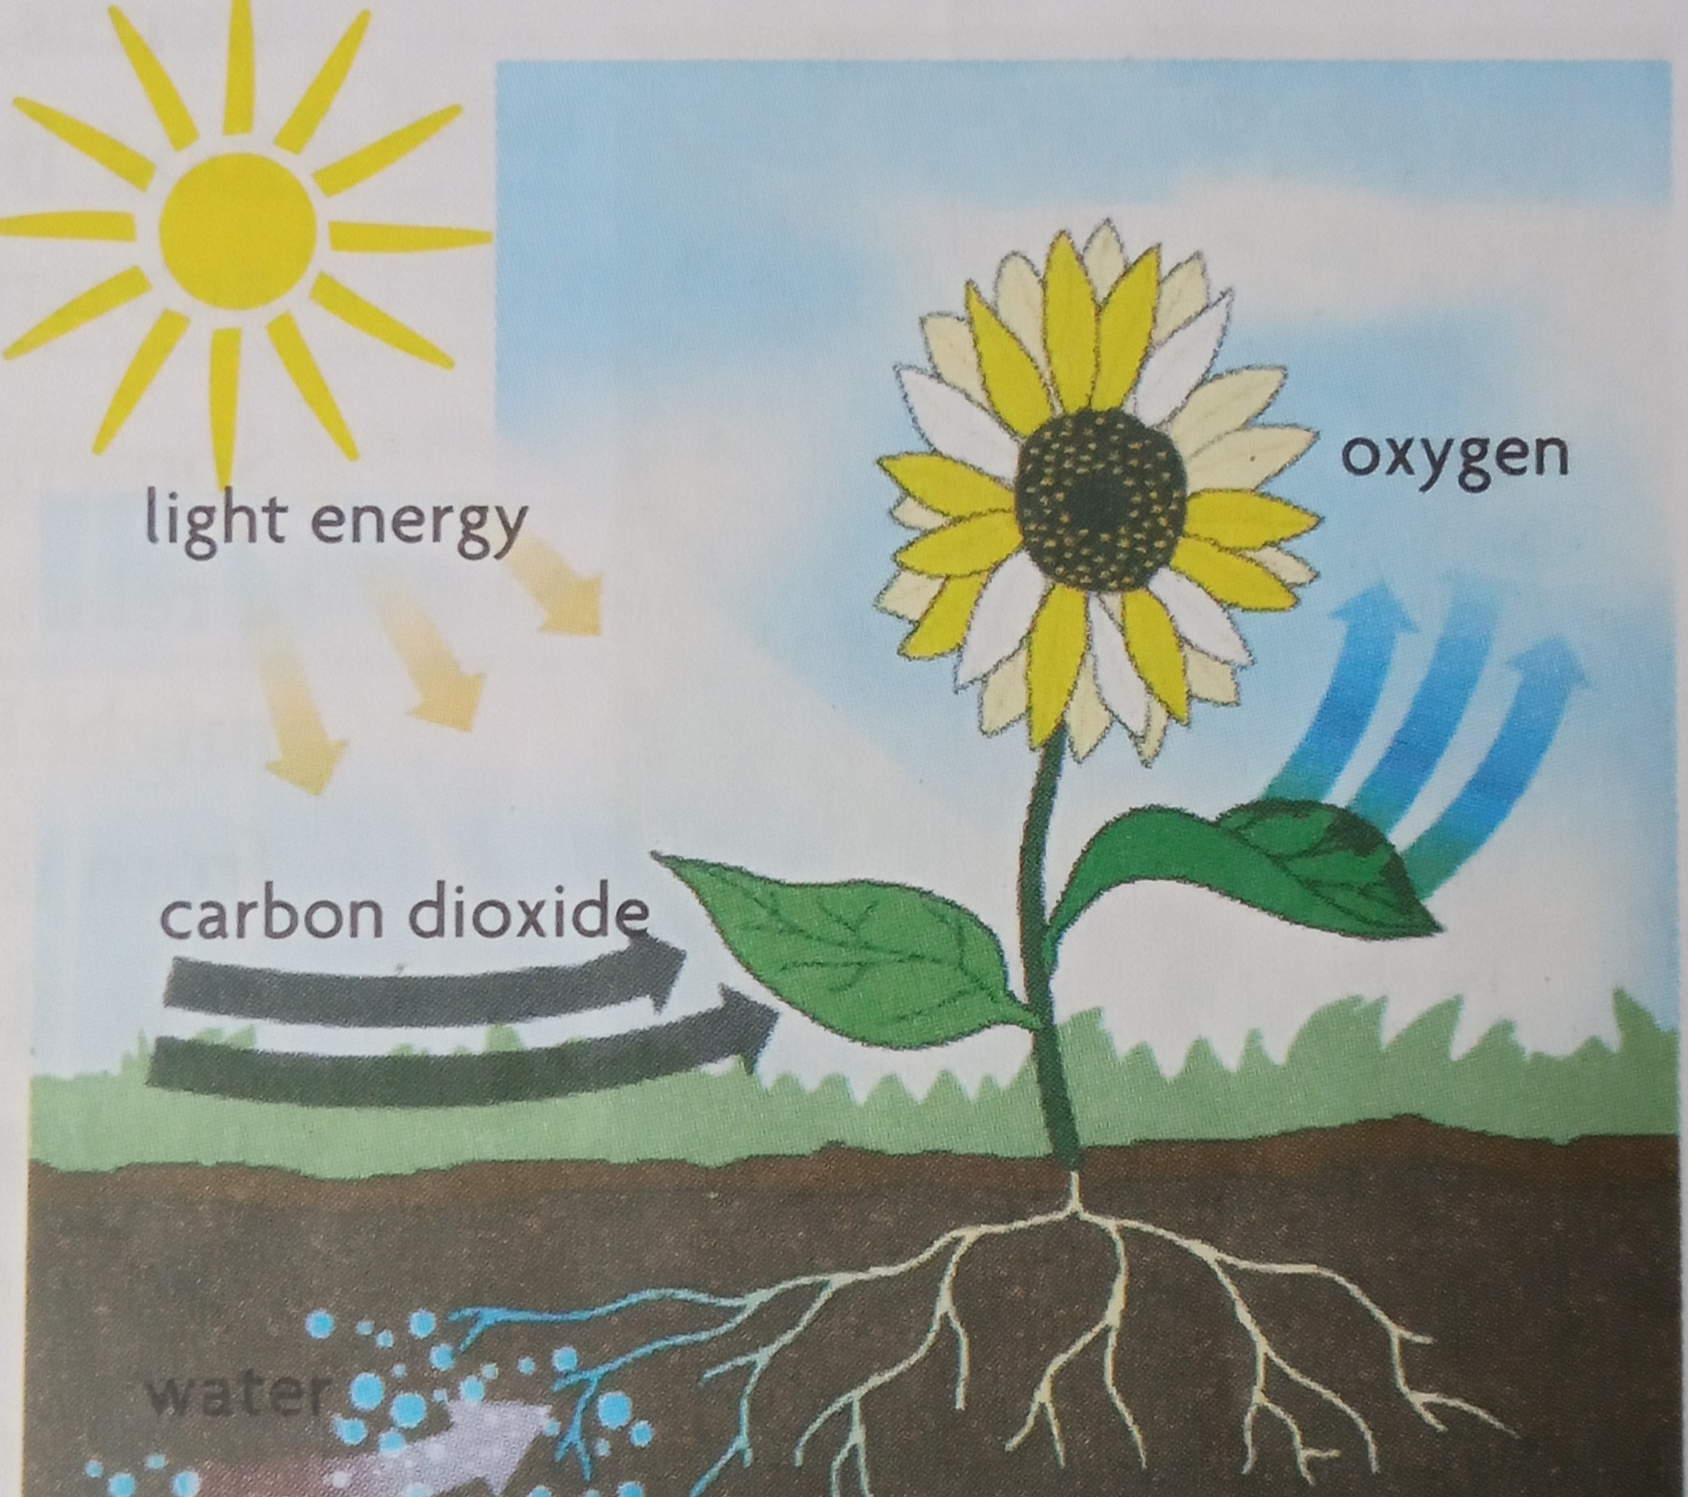
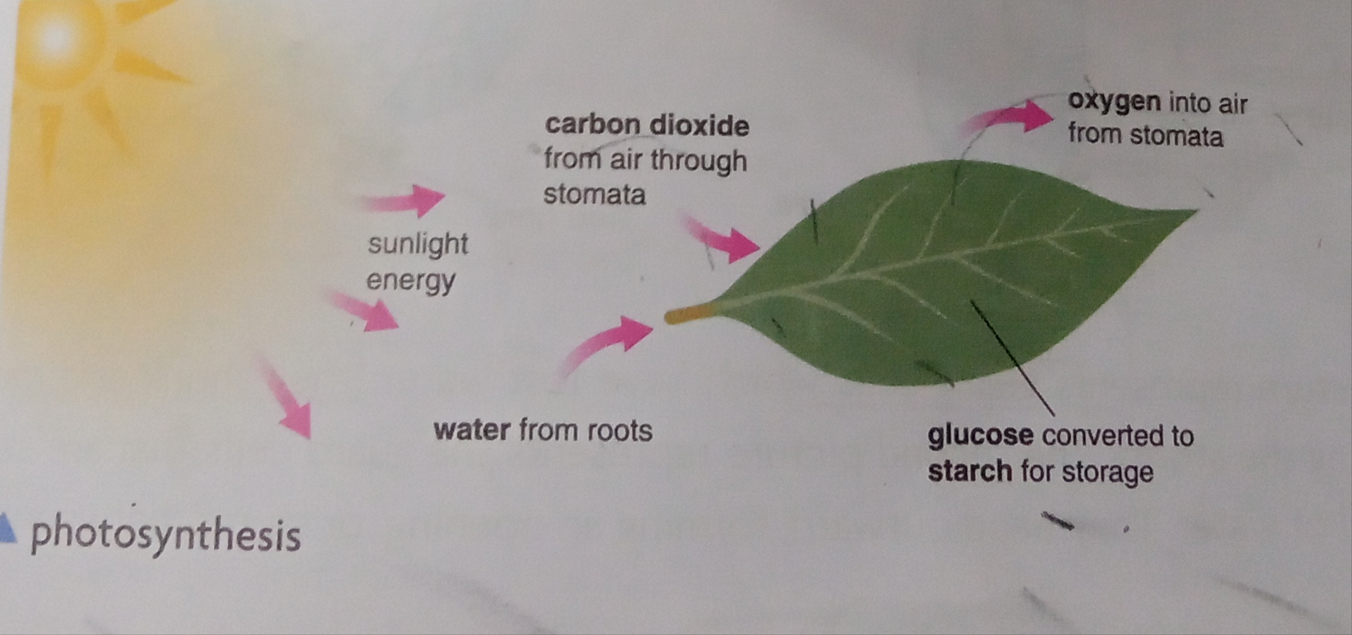
Autotrophic Nutrition

Slide 3
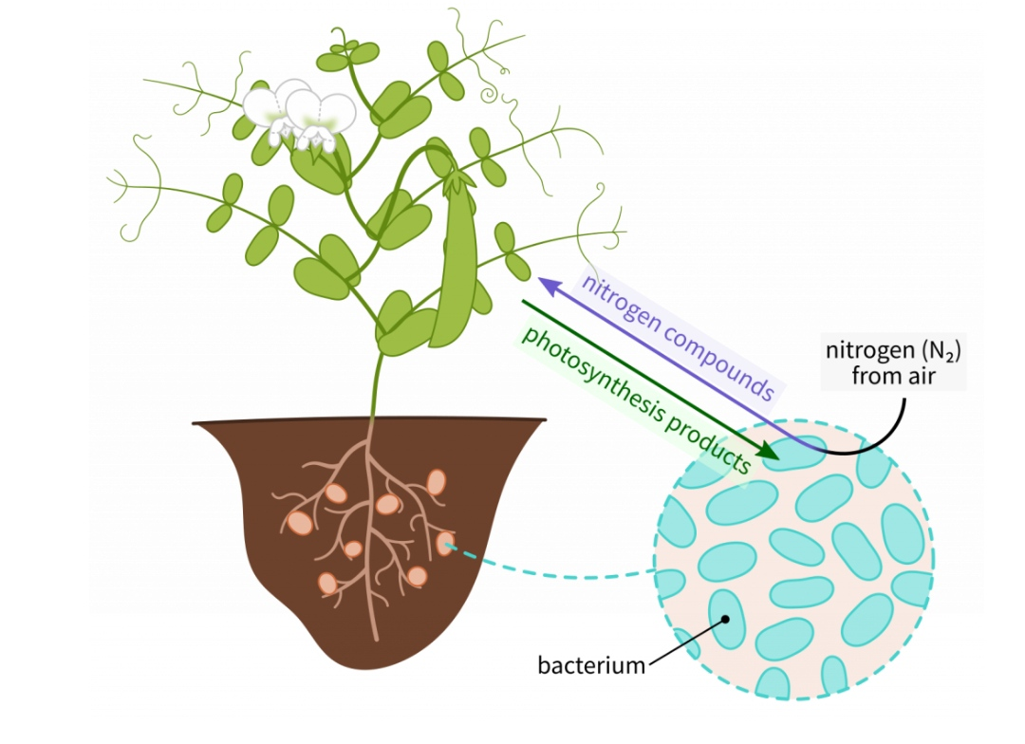
Synthesis of food other than carbohydrates:
Proteins contain nitrogen
Plants absorb in two ways
  Rhizobium
  Fertilizers

Slide 4
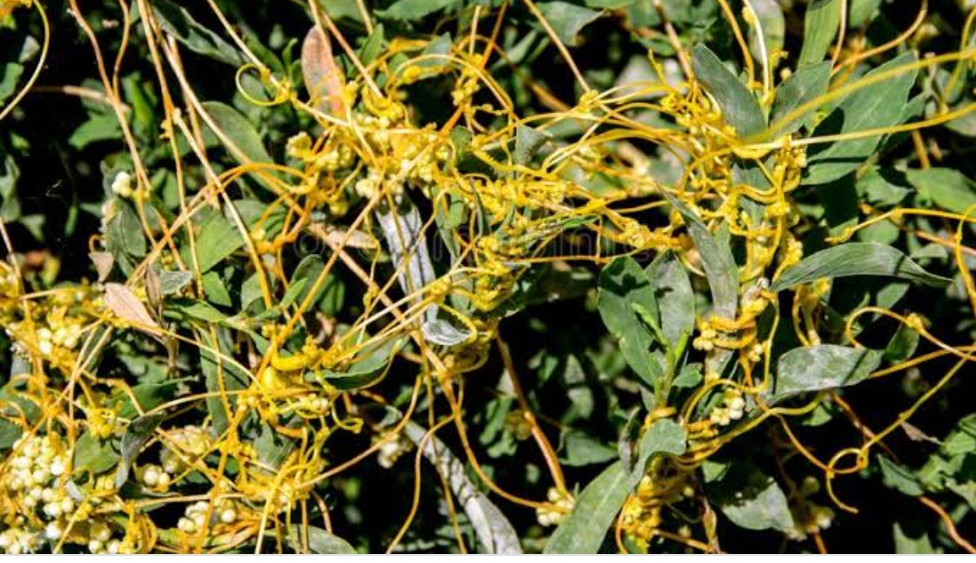
Heterotrophic Nutrition:
Animals including human beings, non-green plants and bacteria
Three different types of animals
Sun – Ultimate source of energy
Parasites – organisms that obtain their food from other living organisms, called hosts, on which they live.
eg: Dodder (amarbel)

Slide 5
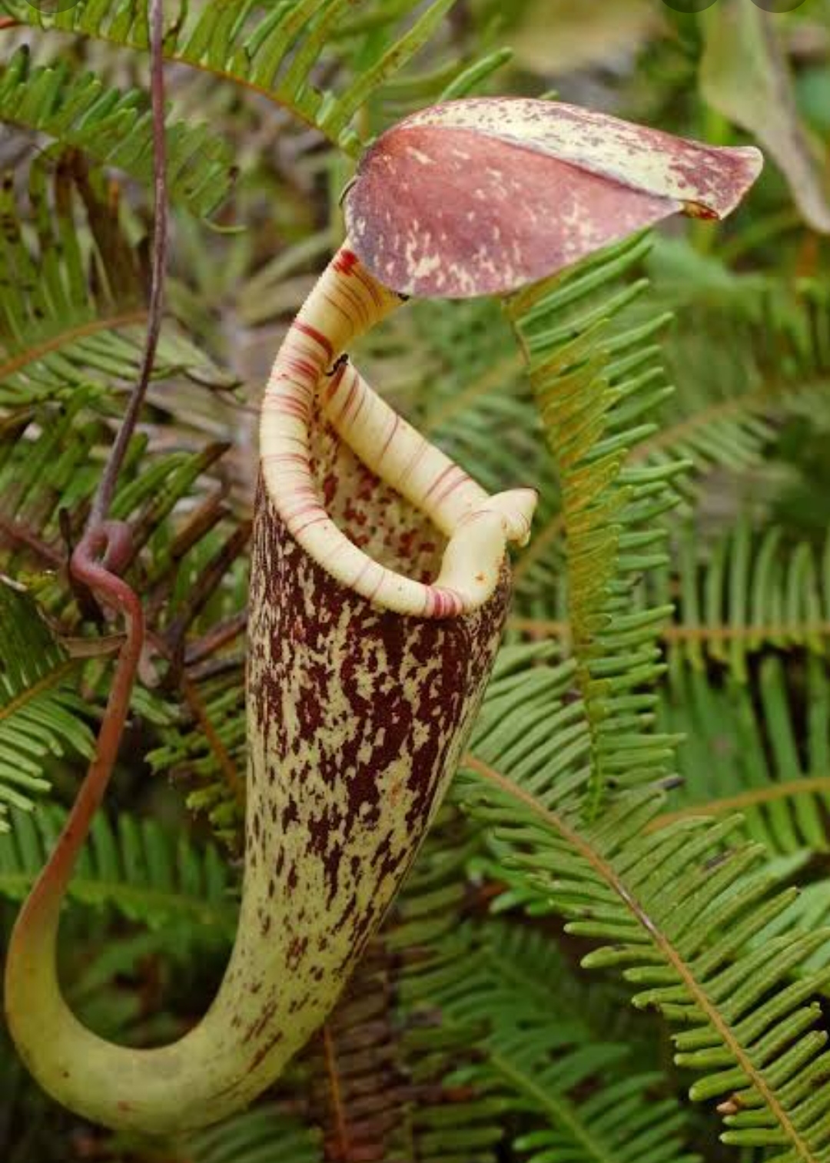
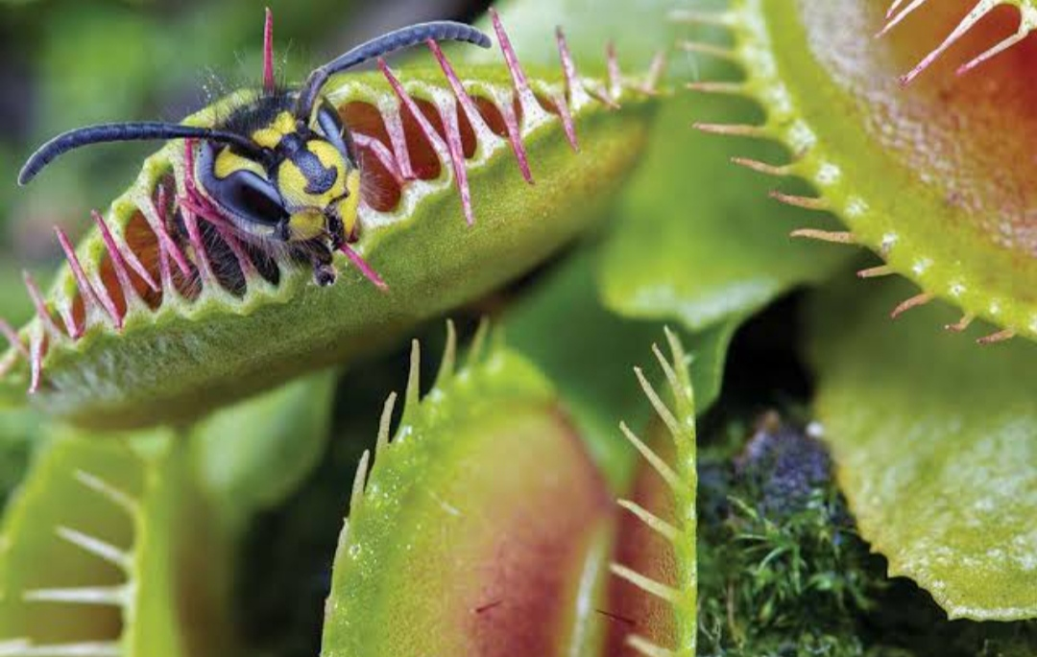
Insectivorous plants(trap insects to meet nitrogen requirement)
Venus flytrap
Pitcher plant(leaf is modified as pitcher-like structure with lid)

Slide 6
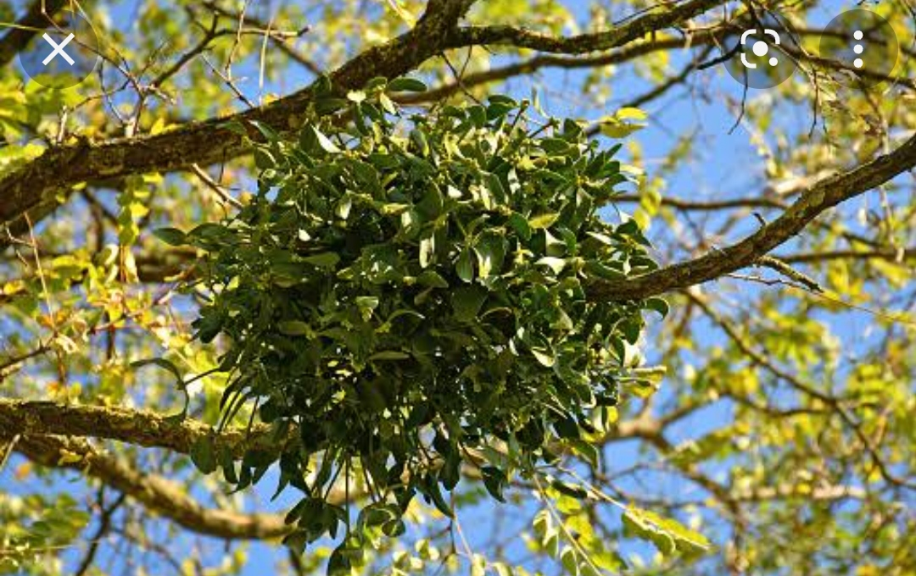
Heterotrophic Nutrition:
Parasites
Mistletoe (partial parasite)
Grow on trees such as mango or mahua – synthesize its food but depends host for water and minerals

Slide 7
Parasitic bacteria
Diseases:
Typhoid
Cholera
Tuberculosis
Sore throat

Slide 8
Decomposer- Saprophytic fungi and bacteria
Benefits:
  Help farmers in making compost and manure
  By decaying the organic matter

Slide 9
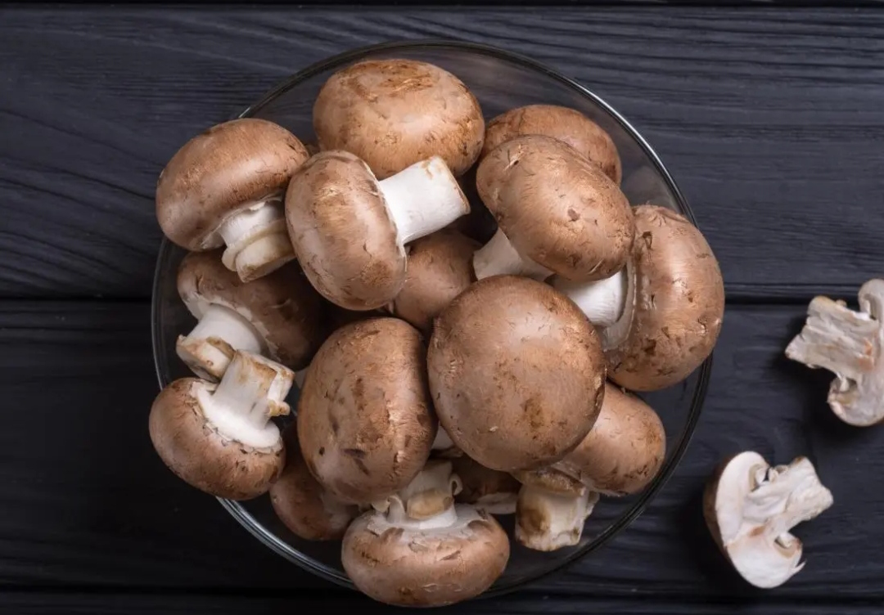
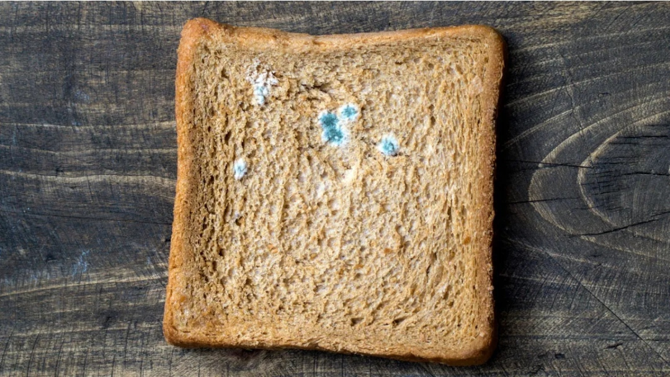
Saprotrophs
Non-green plants that live on dead and decaying plants and animals
Fungi growing on bread

Slide 10
Saprotrophic Nutrition(Getting nutrients from dead and decaying matter in the form of liquid)
Non-green plants secrete digestive juices on dead and decaying matter
Converts solid matter into a liquid
Absorb nutrients from liquid

Slide 11
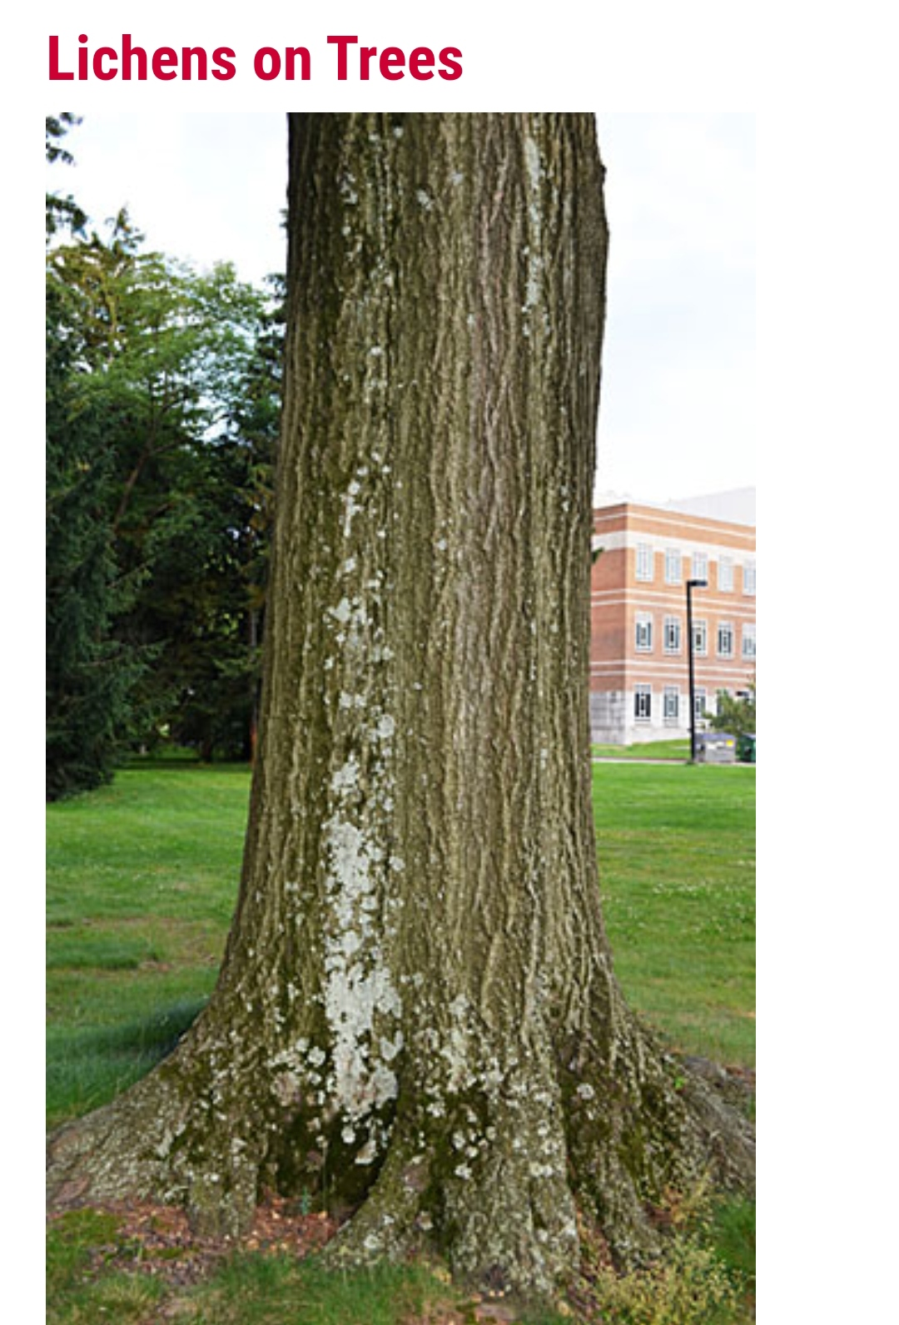
Symbiosis:
Two organisms live together and help each other
Fungi spores floating in the air start geminating when they land on wet and warm things
Alga – Autotroph (food to the fungus)
Fungus – saprophyte(water & minerals to alga)
Live together in lichen

Slide 12
Rhizobium
Cannot make it’s own food
Lives in the roots of leguminous plants for food and shelter
Provides nitrogen to plants
Have symbiotic relation with leguminous plants. No need to add nitrogenous fertilizers.

Slide 13
Replenishing nutrients in the soil:
Naturally – By decaying of dead plants and animals(Forests)
Adding manure and fertilizers (NPK)

Slide 14
Thank you

